Slide 1
2023.2 CPN Maintenance Release Education
Centricity Perinatal (CPN) Standard Database Updates
General Enhancements, Regulatory Requirements
Women’s and Children’s Services
April 2023

Slide 2
Contents
Neonatal
  NICU Airway Type Outbound
  Newborn Sepsis Calculator URL
  NSY Feeding Comments
  Notifications
  Braden QD Skin Assess for NSY
  Add Maternal/Newborn Fall Safety
Perinatal
  Hemorrhage Risk Assessment Update
  Oxytocin In-Use Checklist Update
  Magnesium Checklist Update
  Notifications
  Braden II Skin Assess for Adults
  Abuse Risk Update
  Advance Directive Update
  Update Maternal Risk Factors

Slide 3
Perinatal
Labor and Delivery, OBGYN and Postpartum/MBU
Women’s and Children’s Services

Slide 4

Hemorrhage Risk Assessment Updates
Rationale for Change:
HCA has adopted its own Hemorrhage risk tool based off of CMQCC and AWHONN hemorrhage risk tools to be used for documentation.
Hemorrhage risk assessment can be documented based on facility policy on admission, before delivery, in postpartum and as needed.
RISK OF POSTPARTUM
HEMORRHAGE

Slide 5
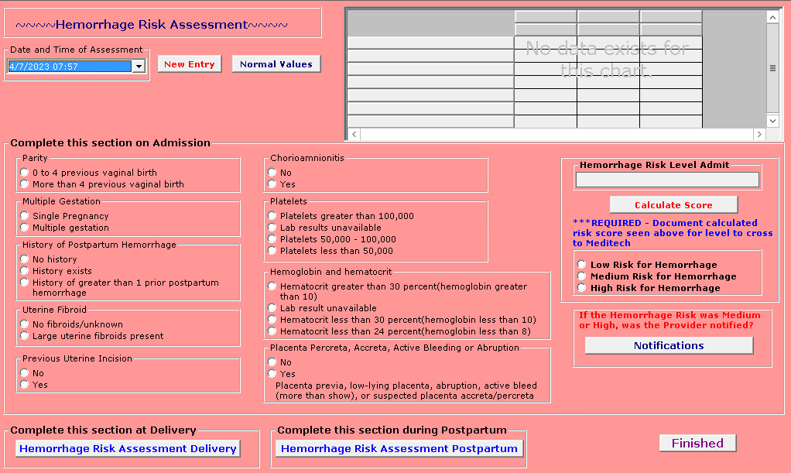
What will change in CPN for the Admission Assessment:
New items added: Platelets and Hemoglobin/Hematocrit
Removal of BMI item.
**Still need to choose Risk Level: Low, Medium or High for the value to send to Meditech**

Slide 6
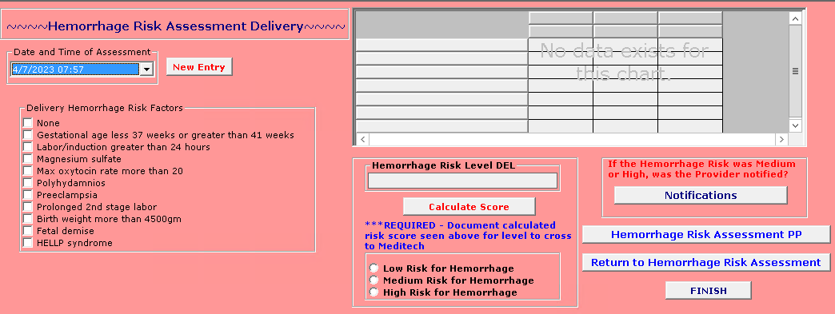
What will change in CPN for the Delivery Assessment:
Delivery Hemorrhage Risk Factors updated.
**Still need to choose Risk Level: Low, Medium or High for the value to send to Meditech**

Slide 7
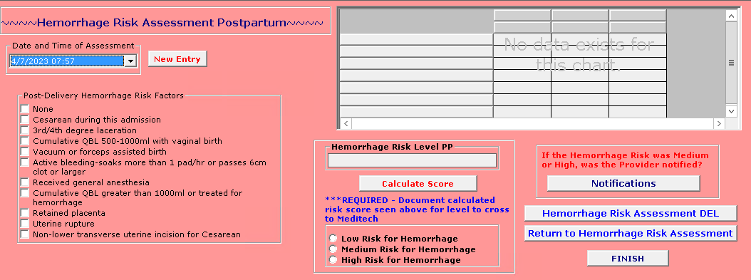
What will change in CPN for the Postpartum Assessment:
Post-Delivery Hemorrhage Risk Factors updated.
**Still need to choose Risk Level: Low, Medium or High for the value to send to Meditech**

Slide 8

Oxytocin In-Use Checklist Update
Rationale for Change:
Verbiage for the number of contractions time period needs to be updated to current guidelines. This will also align the In-Use Checklist across EHR platforms.
Oxytocin In-Use Checklist

Slide 9
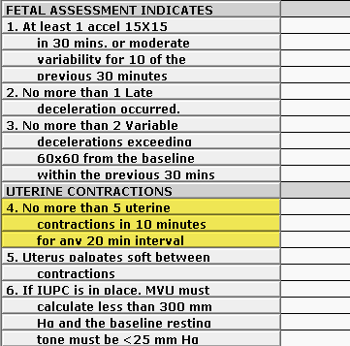
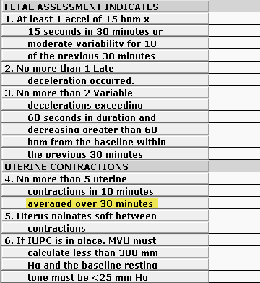
What will change in CPN:
Verbiage for the number of contractions time period will be updated.
Question will change from “No more than 5 uterine contractions in 10 minutes, for any 20 minute interval.” to “No more than 5 uterine contractions in 10 minutes averaged over 30 minutes.”

Slide 10

Magnesium Checklist Update
Rationale for Change:
Remove information from Magnesium Checklist that references specific parameters for documentation.
Staff should look at current facility policies related to Magnesium documentation.
Magnesium Checklist

Slide 11
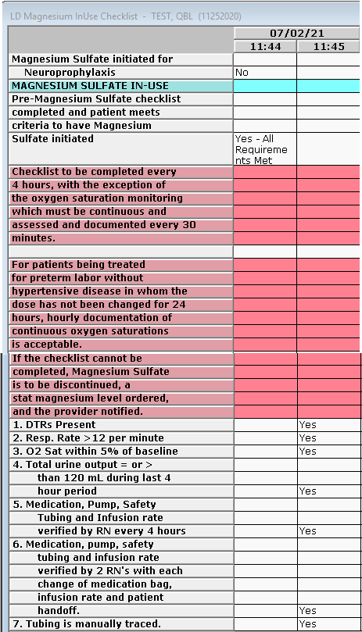
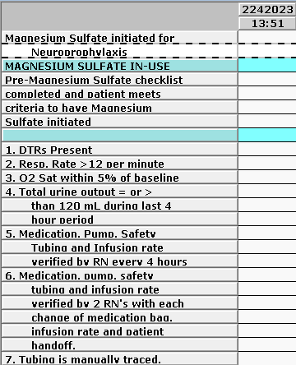
What will change in CPN:
Removal of checklist completion instructions from Magnesium Sulfate Checklist, LD Flowsheet and Ante/OBED Flowsheet.

Slide 12

Notifications
Rationale for Change:
Combine all Notifications into one chart/form.
Match Meditech Notification selections.
Will keep Urgent Provider/Hospitalist request item at this time.
Notifications

Slide 13
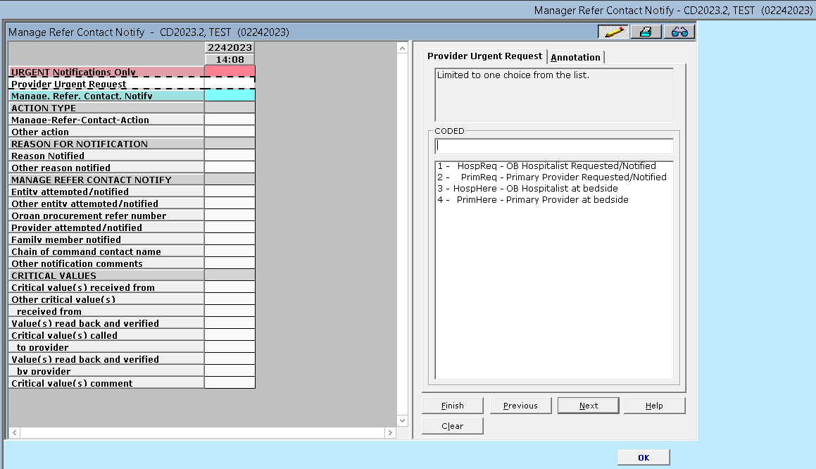
What will change in CPN:
New chart with Notification items
The column time is the time that the manage/refer/contact/notify occurred.

Slide 14
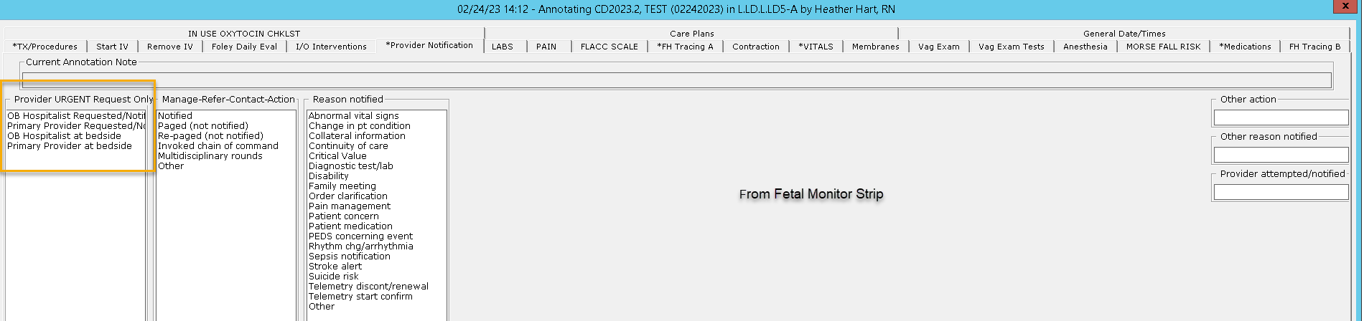
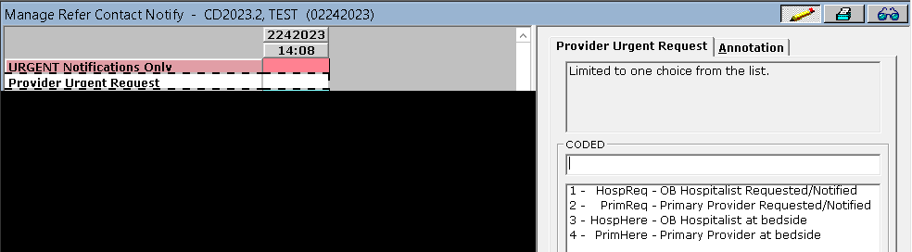
How to use URGENT Notifications Only:
Should ONLY use the Provider Urgent Request item for Urgent Provider/Hospitalist Request/Notify and when the Provider or Hospitalist is at the bedside after urgent request.
All other notifications should be completed Under Manage, Refer, Contact, Notify Section

Slide 15
How to use Manage, Refer, Contact, Notify:
Manage-Refer-Contact-Action > What you are doing or did
    Examples: Notified the provider, Paged Anesthesia, participated in multidisciplinary rounds
Reason for Notification > Why you are notifying or paging/re-paging
    Example: Order clarification
Entity Attempted/notified > Use for anything other than provider. Who you notified or paged.
Organ procurement reference number – Number provided from organ procurement
Provider attempted/notified > Provider name
Family member notified > Family member/members name
Other notification comments > use only if unable to document fully from the items above.
Critical Values section used when critical values are being reported.

Slide 16

Braden II Skin Assessment
Rationale for Change:
Braden II Skin Assessment for adults will be added to Antenatal, Labor and Postpartum documentation.
Copyright: © 2022 Health Sense Ai. All rights reserved. All copyrights and trademarks are the property of Health Sense Ai or their respective owners or assigns.
Perinatal Services are excluded from Clinical Safety Improvement Plan (CSIP) reporting.
Braden II Skin Assessment

Slide 17
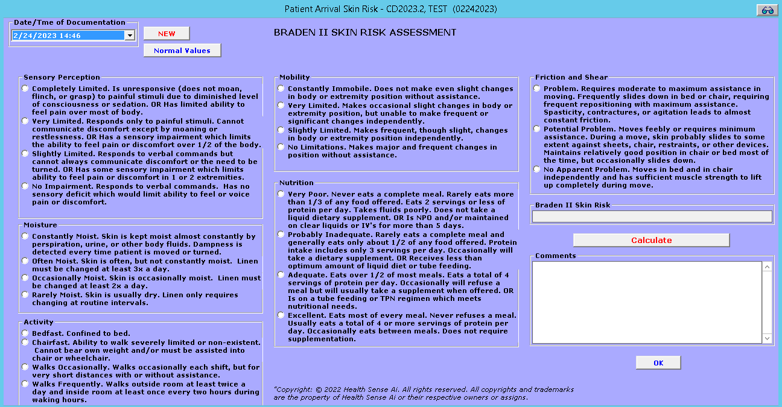
What will change in CPN:
Current Skin Risk Assessment on labor admission, PP direct admission and shift assessments will be updated for maternal patients for documentation.

Slide 18
Abuse Risk Assessment Update
Rationale for Change:
The Abuse Risk Assessment has been updated to reduce the likelihood of adverse patient safety events and to meet regulatory requirements. These abuse fields must be captured on every inpatient. “Unable to assess" has been added as an option if the patient or family is not able to provide the information.
Every attempt should be made to answer “Yes” or “No” prior to discharge.
Abuse Risk Assessment

Slide 19
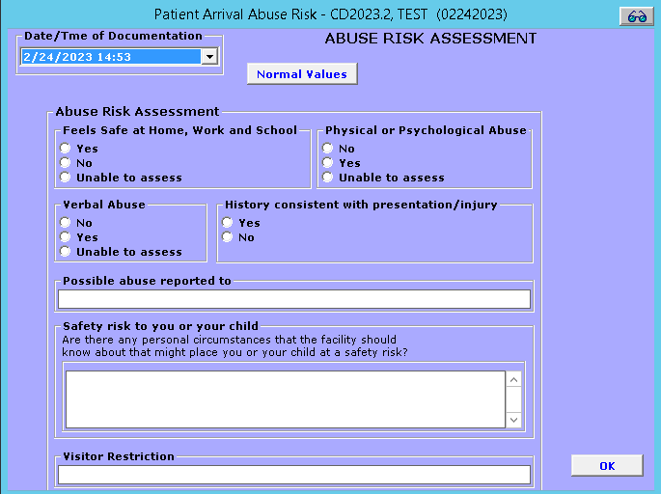
What will change in CPN:
New option of “Unable to assess” answer.
Before discharge you should attempt to answer the abuse risk questions with either a yes/no.
Additional items added to fully capture abuse risk.

Slide 20
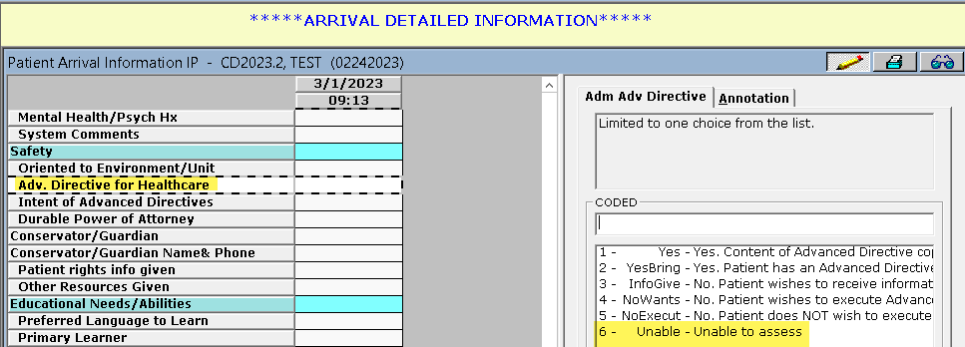
Advance Directive Update
Rationale for Change:
The Advance Directive answers will include Unable to Assess as a choice. This will match Meditech documentation that was updated with the Meditech 2023.1 Release.
What will change in CPN:
Advance Directive

Slide 21
Maternal/Newborn Fall Safety
Rationale for Change:
Updated answers added to Maternal Risk factors for newborn drop/falls assessment.
Removal of Newborn and Maternal Fall Prevention
  Standard of care
Newborn Fall Education will be removed from assessment
  Documentation should be completed on the Teaching record.
Match Meditech documentation
Toolkit: Toolkits and Guides - Women's and Children's Services - Atlas Connect (medcity.net)
Maternal/Newborn Fall Safety

Slide 22
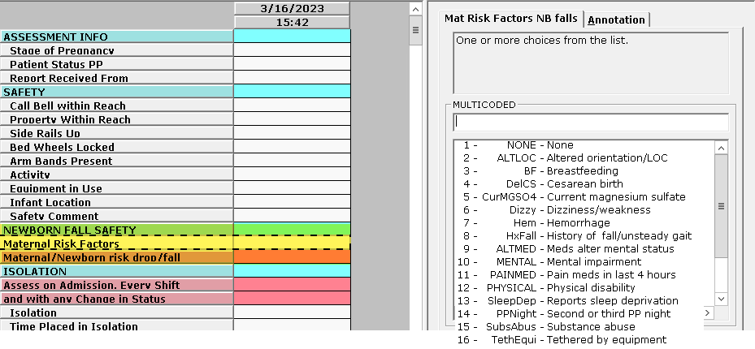
What will change in CPN:
Maternal Risk Factors will have additional available answers
Will calculate maternal/newborn risk for drop or fall: No Risk or At Risk

Slide 23
Neonatal
Nursery and NICU
Women’s and Children’s Services

Slide 24
NICU Airway Type Outbound
Rationale for Change:
When documentation is entered for NICU Airway type and NICU airway type other it will be sent to Meditech.
What will change in CPN:
Under the down tab > Outbound MU audit chart will include NICU Airway type and NICU airway type other. Updated to include all outbounded items to Meditech for Nursery and NICU.
Outbound – NICU Airway Type

Slide 25

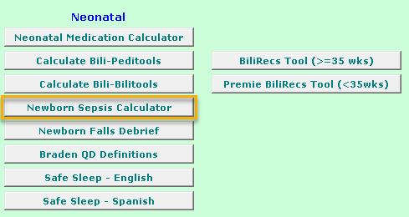
Newborn Sepsis Calculator URL
Rationale for Change:
The current Newborn Sepsis Calculator website is not secure and is not working.
Approval to update to the Kaiser Newborn Sepsis Calculator: https://neonatalsepsiscalculator.kaiserpermanente.org/
End Users should consult with NICU Medical Director to determine Incidence of Early Onset Sepsis
What will change in CPN:
Newborn Sepsis Calculator URL

Slide 26


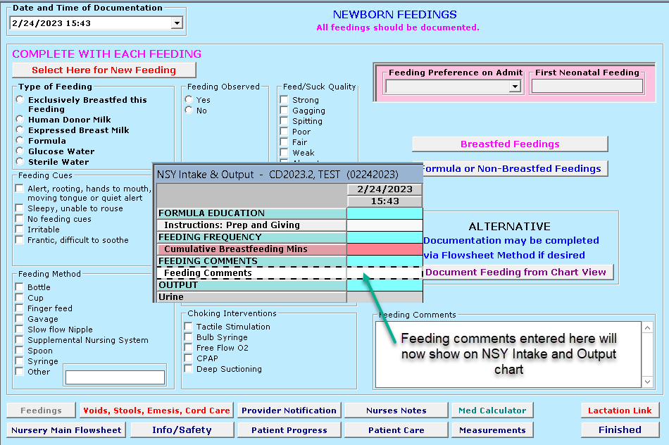
Nursery Feeding Comments
Rationale for Change:
In a prior CPN Change the Neonatal feeding comments item change to a new item and was not updated on flowsheets.
What will change
in CPN:
Nursery feeding comments

Slide 27
Notifications
Rationale for Change:
Combine all Notifications into one chart/form.
Match Meditech Notification selections.
Notifications

Slide 28
What will change in CPN:
New chart with Notification items
The column time is the time that the manage/refer/contact/notify occurred.

Slide 29
How to use Manage, Refer, Contact, Notify:
Manage-Refer-Contact-Action > What you are doing or did
    Examples: Notified the provider, Paged Anesthesia, participated in multidisciplinary rounds
Reason for Notification > Why you are notifying or paging/re-paging
    Example: Order clarification
Entity Attempted/notified > Use for anything other than provider. Who you notified or paged.
Organ procurement reference number – Number provided from organ procurement
Provider attempted/notified > Provider name
Family member notified > Family member/members name
Other notification comments > use only if unable to document fully from the items above.
Critical Values section used when critical values are being reported.

Slide 30

Braden QD Skin Assessment for newborns
Rationale for Change:
Braden QD Skin Assessment for Well Newborns will be added to nursery assessment documentation.
Neonatal Skin Condition Score is no longer used and will be removed.
Copyright Curley, M.A.Q., Hasbani, N.R., Quigley, S.M., Stellar, J.J., Pasek, T.A., Shelley, S.S., Kulik, L.A., Chamblee, T.B., Dilloway, M.A., Caillouette, C.N., McCabe, M.A., Wypij, D., (2018) Predicting pressure injury risk in pediatric patients: the Braden QD Scale. J Pediatr 2018;192:189-95).
What will change in CPN:
Nursery Admission and Nursery Assessment charts will have Braden QD added.
Braden QD Skin Assess for newborns

Slide 31
Maternal/Newborn Fall Safety
Rationale for Change:
Updated answers added to Maternal Risk factors for newborn drop/falls assessment.
Removal of Newborn and Maternal Fall Prevention
  Standard of care
Newborn Fall Education will be removed from assessment
  Documentation should be completed on the Teaching record.
Match Meditech documentation
Toolkit: Toolkits and Guides - Women's and Children's Services - Atlas Connect (medcity.net)
Maternal/Newborn Fall Safety

Slide 32
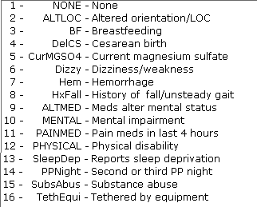

What will change in CPN:
Newborn Fall Safety will be added to Nursery and NICU admission and assessment
Will calculate maternal/newborn risk for drop or fall: No Risk or At Risk

Slide 33


Questions
Updates will be available in standard CPN environments.
Any questions or comments, please contact your division CPN System Administrator with any questions.
Thank you!

