Slide 1
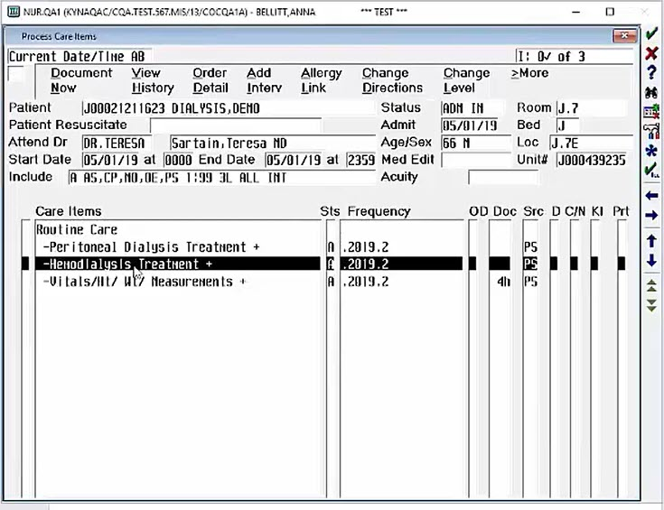
Documentation for CHHTs
Detail: Our CHHT colleagues assist with hemodialysis in our units. It is important to know the scope of the CHHT and the documentation they are able to enter within the EHR. CHHTs have specific tasks and functions that must be documented before, during, after treatment.
Appropriate documentation:
Patient weights: Pre and post treatment
Vital Signs: Pretreatment every 15 to 30 minutes per facility policy & physician order during and post treatment
Start/Stop date & time of dialysis treatment
Document the pressures on the machine while dialysis is in session – completed after initiation of the treatment every 15 minutes or 30 minutes pending facility policy
Access/De-access a Graft/Fistula (only when competency is complete)
Updated: 04/12/2022 HCA Healthcare Center for Clinical Advancement

