Slide 1
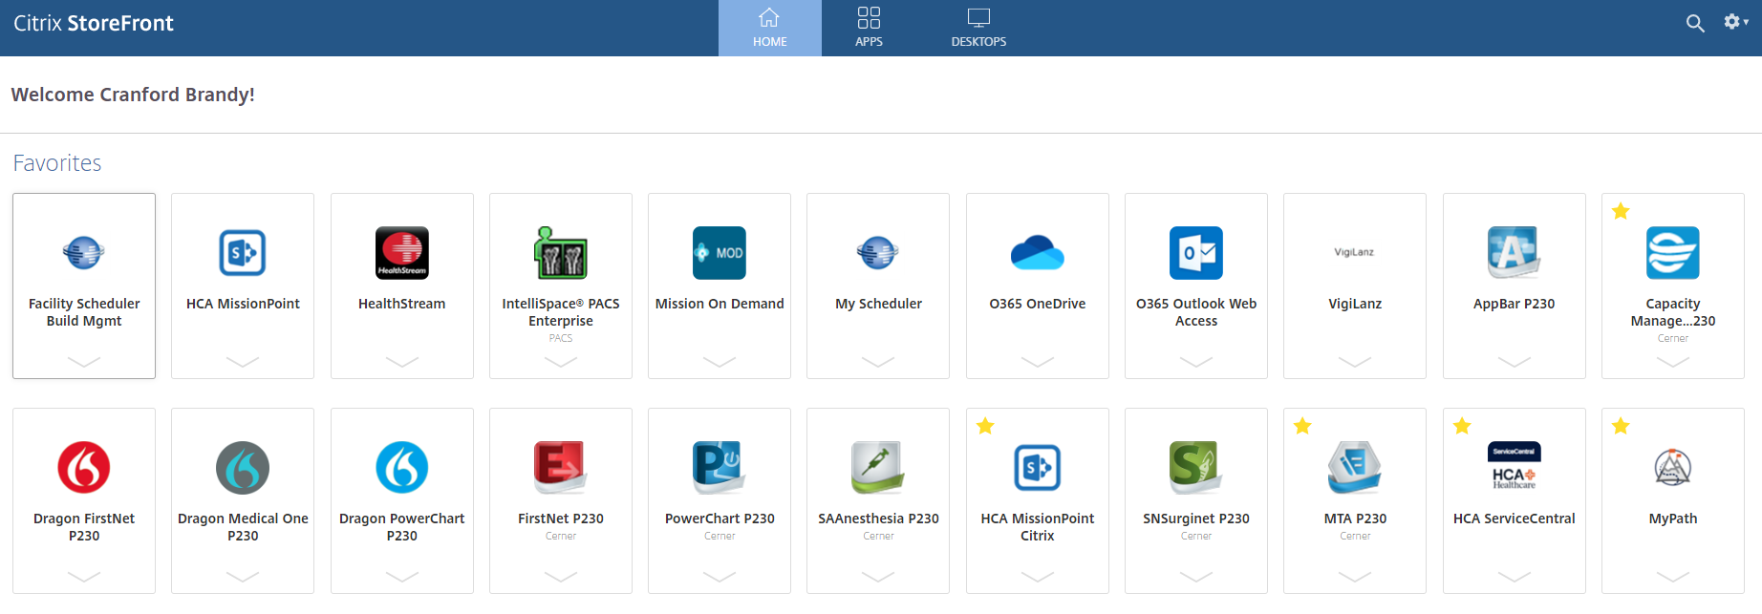
Starting on December 5th, you will no longer access SurgiNet for surgical documentation! You will now be able to access everything you need in PowerChart. After go-live, use the icon circled in red below to use P230.

Slide 2

Periop - Nurse
Combines the following positions into one named “Periop – Nurse”
    Nursing-Peri-Op RN
    SN RN
    Nursing-ASC
    Endoscopy Clinical
Chart opens to Case Selection
Users will notice changes in the order of items as well as additional items in the tool bar and the menu. Screenshot will be provided.
iView bands are location based, so users will have the appropriate bands for the bedded location of the patient.
Updated tracking naming convention for clarity.
  “Perioperative Tracking”
No longer need to use SurgiNet Application for Perioperative Documentation

Slide 3
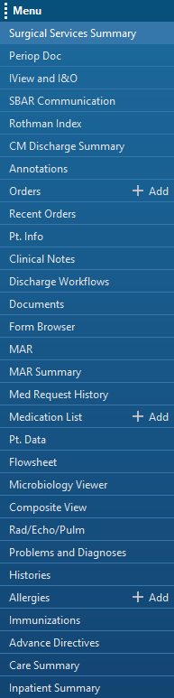
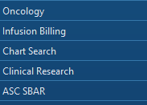
Toolbar and Menu View

