Slide 1



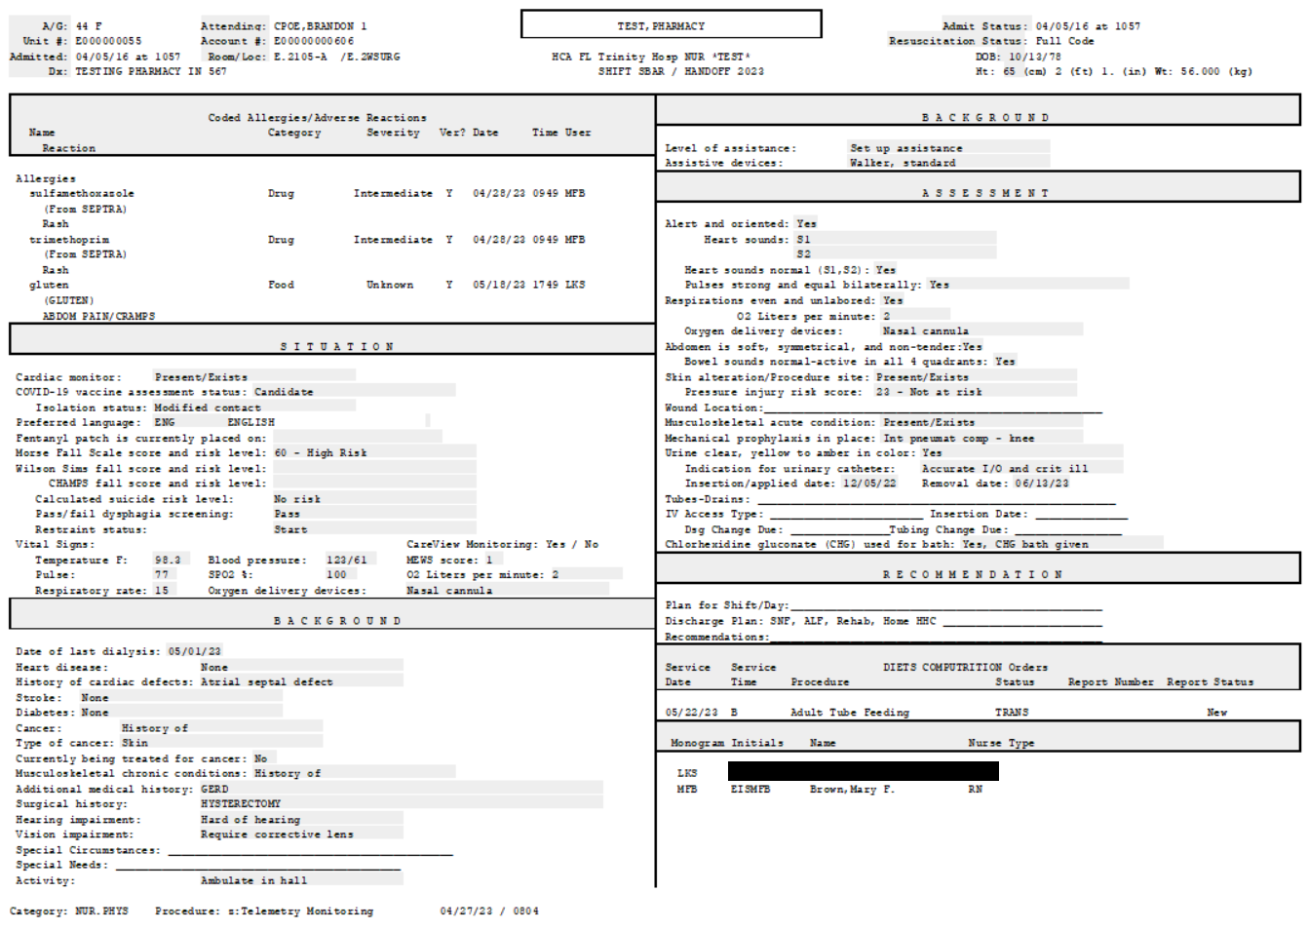

Meditech Reminders
Inpatient Go-live 7-6-2023
Best news of 2023, the *SBAR is
now a 1 page document
*SBAR
(Non Critical Care areas)
Header streamlined
Telemetry orders print at the bottom
Consults, lab results, and orders
no longer print.
Access Clinical Review to
review Patient data
  Contact your facility
  Nursing Analyst for questions

Slide 2
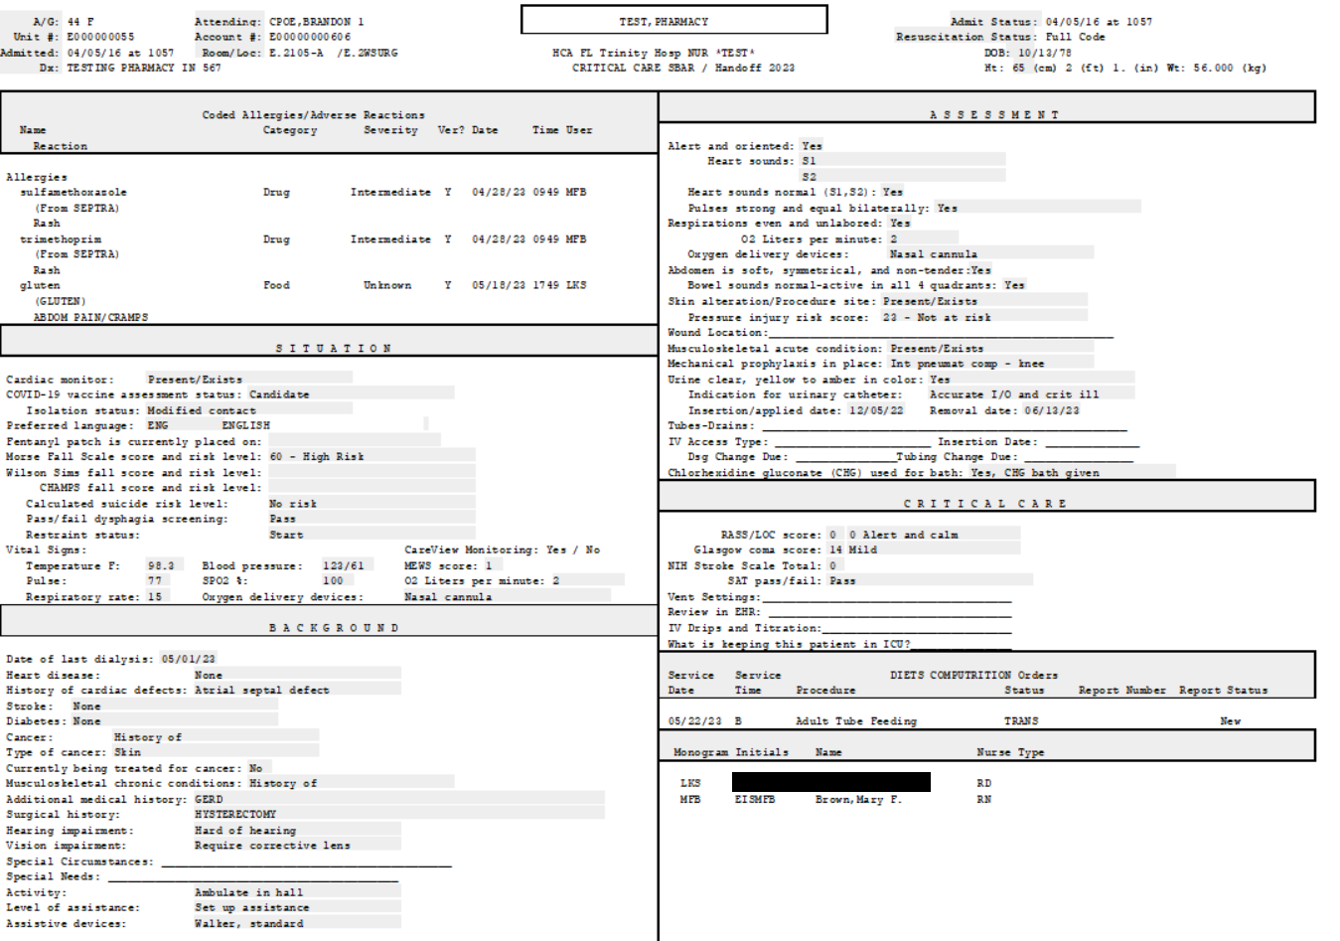
Meditech Reminders
Inpatient
Best news of 2023, the *SBAR CC is
now a 1 page document
*sbar cc
(Critical Care areas)
Header streamlined
Consults, lab results, and orders
no longer print.
Access Clinical Review to
review Patient data
  Contact your facility
  Nursing Analyst for questions

Slide 3
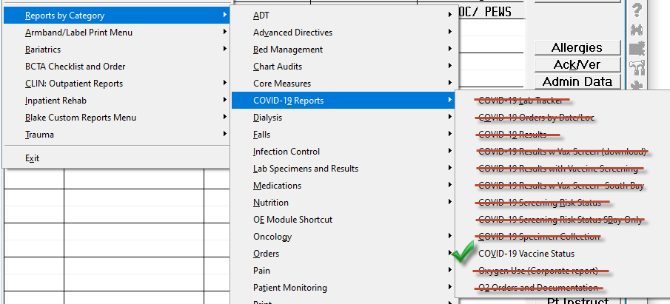
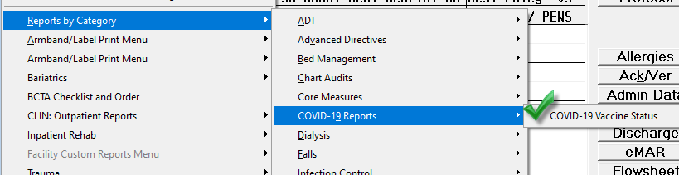
Meditech Reminder
Inpatient
COVID REPORT MENU
Due to low use, all but one COVID 19 report will be removed from the print report button on the status board
Old COVID-19 Report Menu New COVID-19 Report Menu
  Contact your facility Nursing Analyst for questions

Slide 4
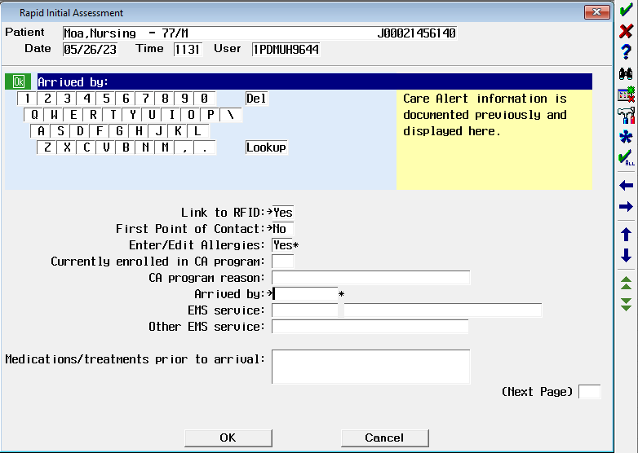
Meditech Reminders
EDM
Mode of Arrival Documentation Update
Situation: Beginning June 15th, 2023, the ER patient’s mode of arrival will pull from nursing documentation in EDM.
Background: Historically, both ER nursing and Registration have asked patients about their mode of arrival when documenting in Meditech. ER patient mode of arrival is captured by nursing in the Rapid Initial Assessment, and by Registration in their documentation module. If there is a discrepancy between the documented modes of arrival, the Registration query overrides the nursing query, even if it is inaccurate. This can lead to an inaccurate medical record and data.
Assessment: We are committed to ensuring accurate data capture as well as the overall effort to ‘ask once’ when conversing with our patients. This year, there was a review of certain required Meditech fields and this question was identified as duplicative and best suited for placement in the clinical workflow process since they are the first point of contact for ED patients. Reporting metrics will pull from the EDM query, going forward, in our Meditech facilities. There is an ongoing effort to restrict the MOA to nurse documentation.
Request: Use this education to teach your nursing staff the importance of accurately capturing the ER patient’s mode of arrival in their documentation. This is a required query so nursing cannot skip the question, and it is critical they enter the accurate mode of arrival.
  Contact your facility Nursing Analyst for questions

